Slide 1
AFSC EBS BTS Survey Net Figure
Emily Markowitz January 12 2025

Slide 2
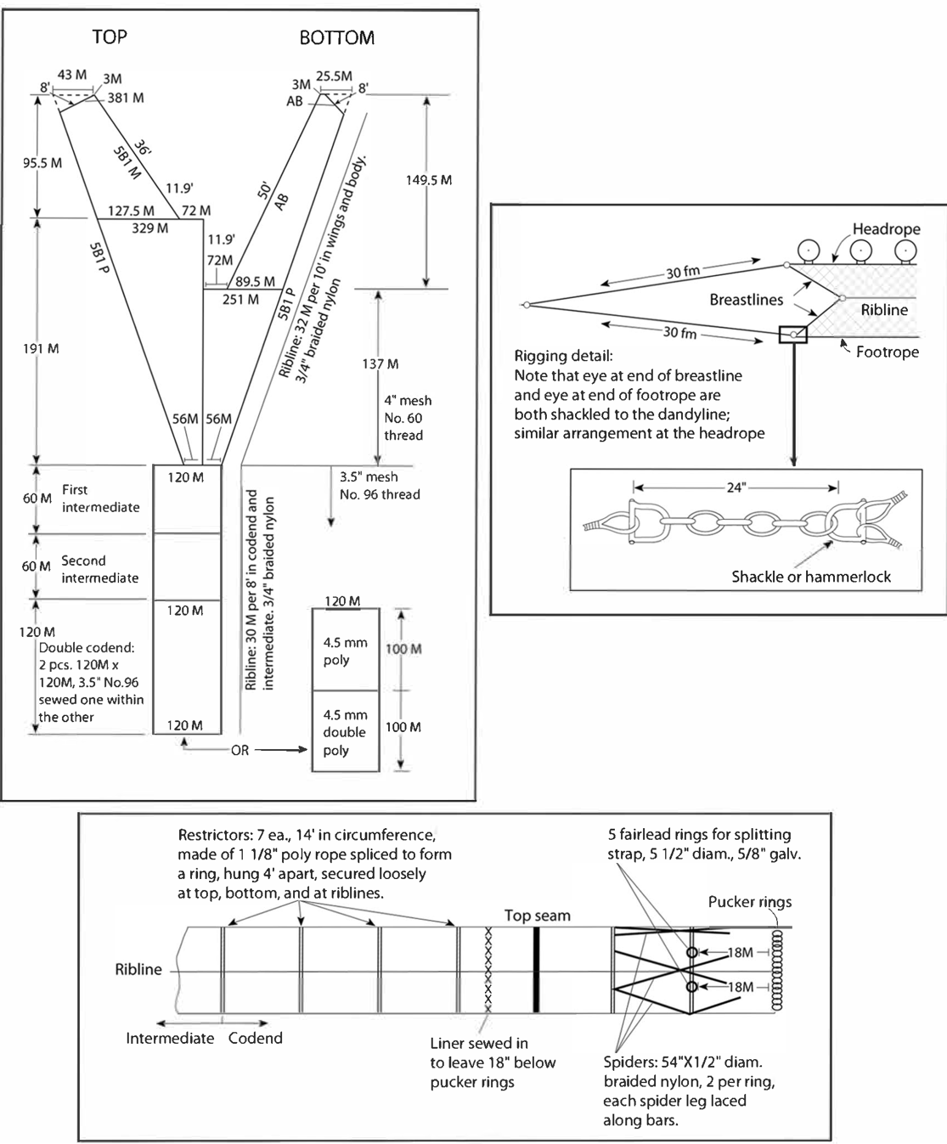
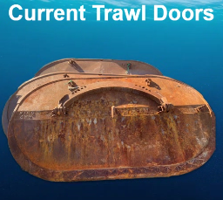
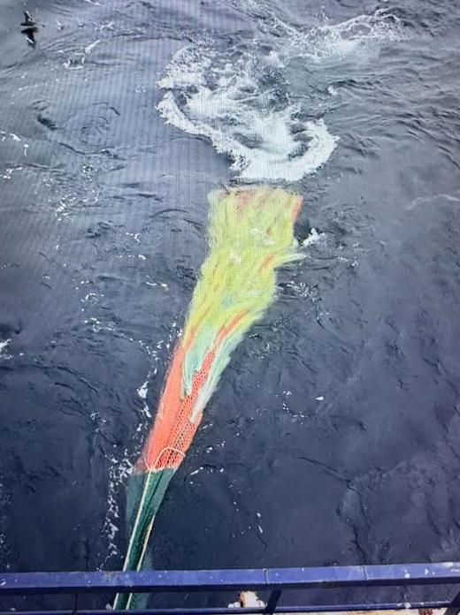
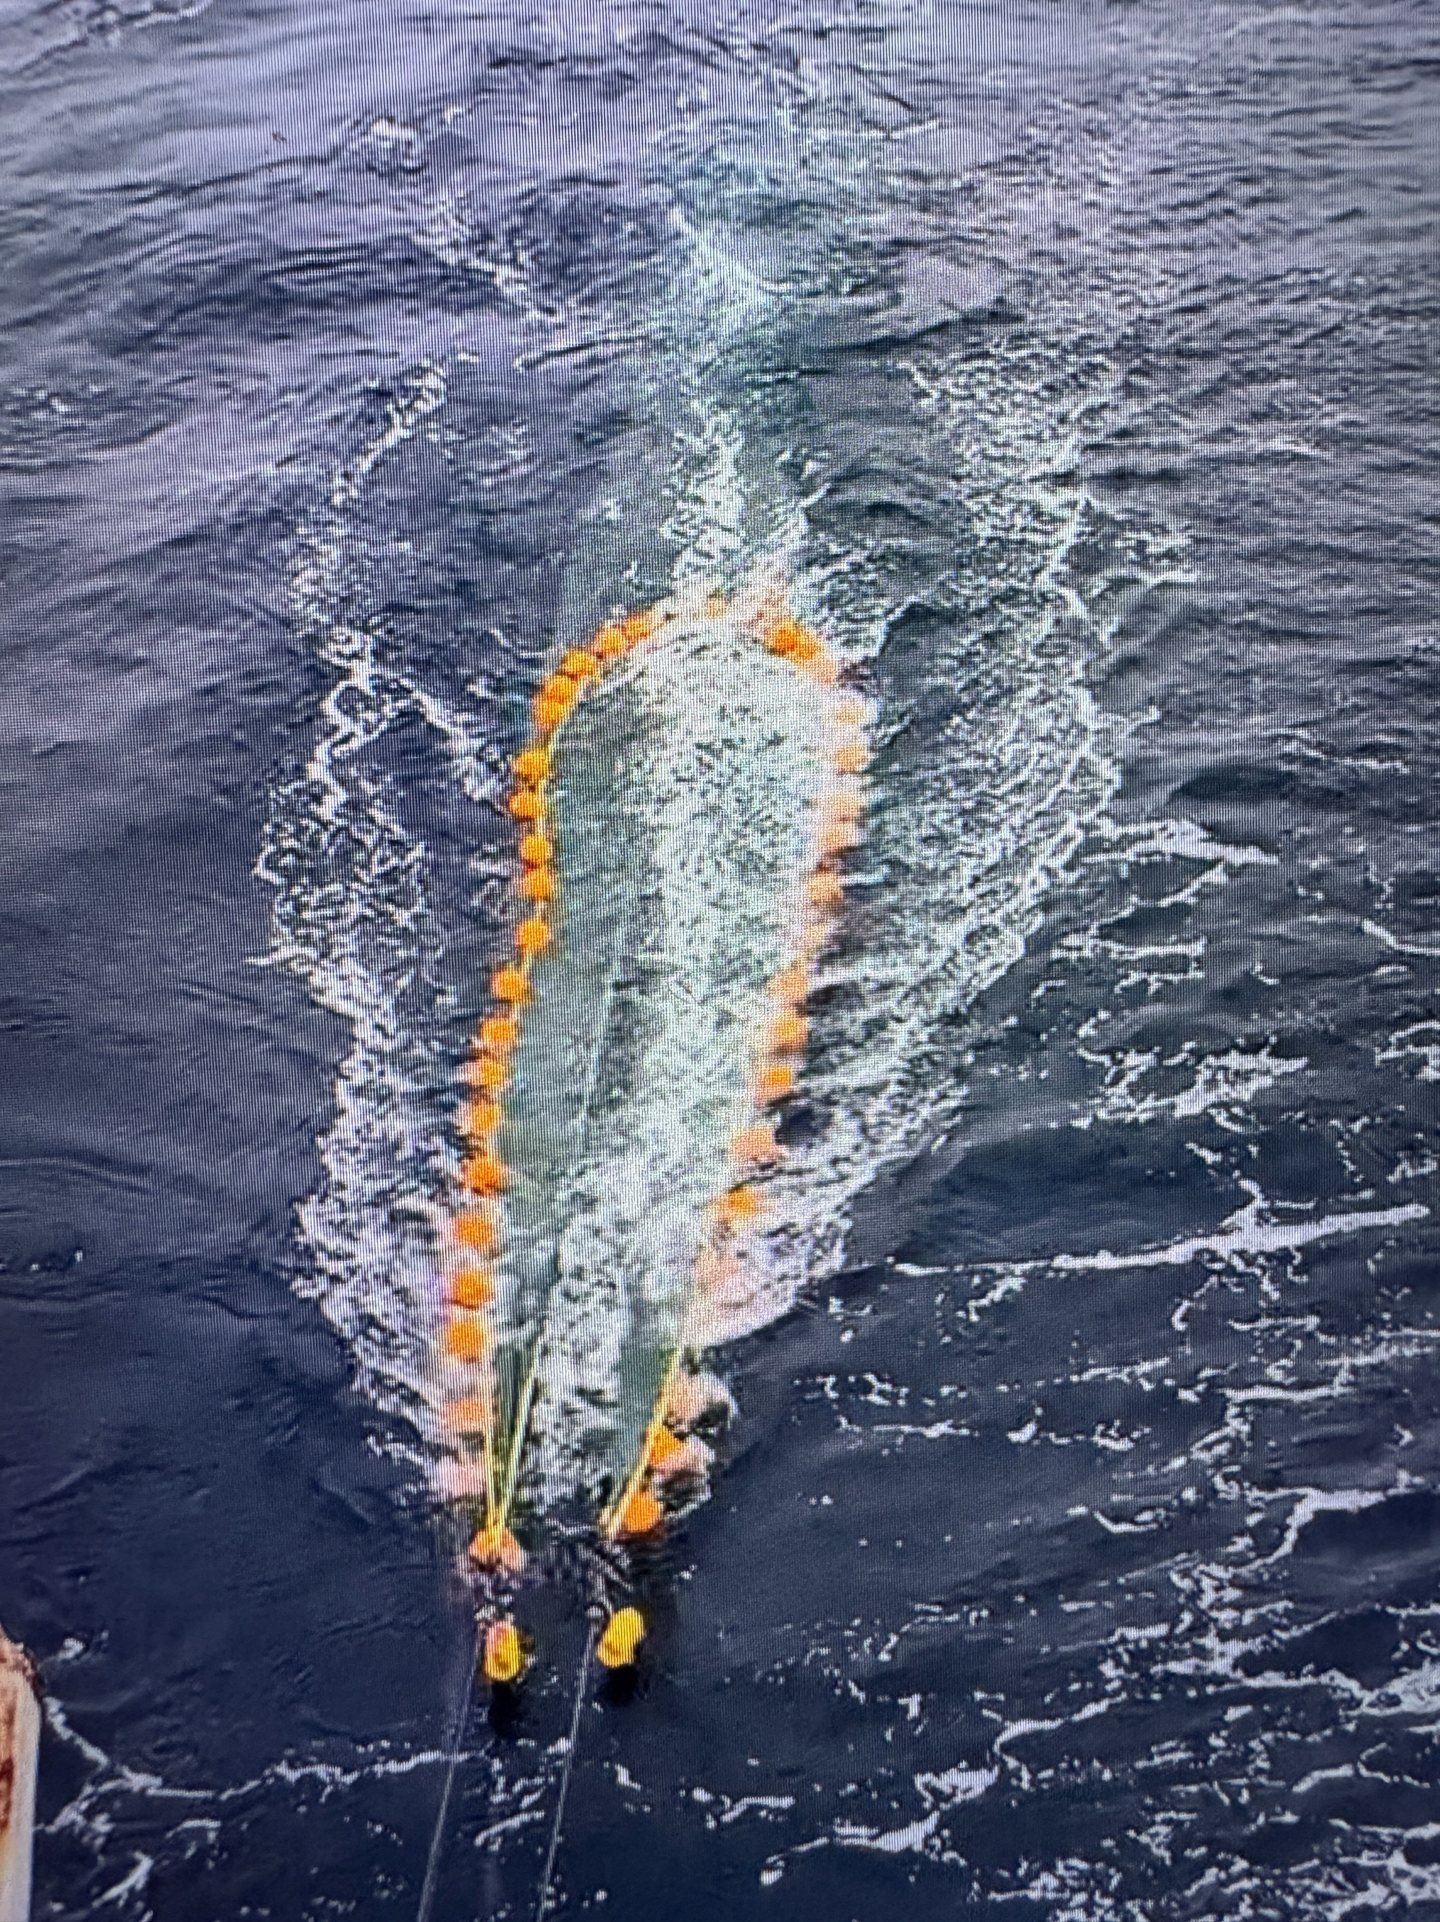
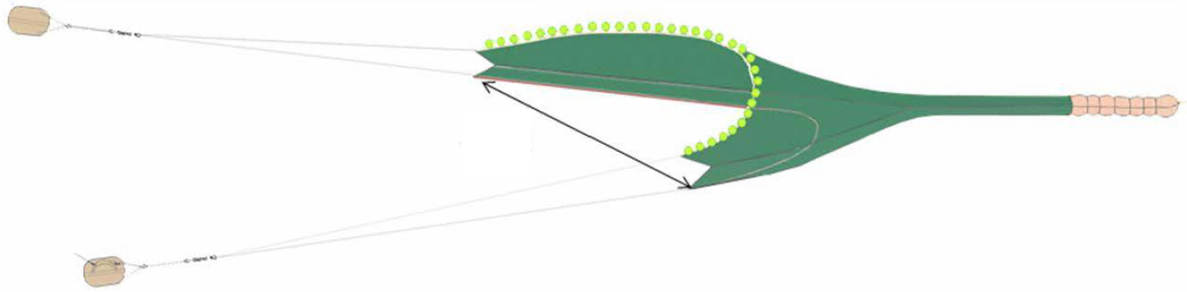
AFSC EBS and NBS Net
For reference

Slide 3
Selvedge
Cod End
TB4
EXT(T)
TB2
EXT(B)
TB3
BB4
TS
TB1
SP4
BB3
Rockhopper Sweep
SP3
BB2
TW1
SP2
BB1
TW1 | Top Wing
SP1-4 | Side Panels 1 through 4
BW1 | Bottom Wing
TS | Top Square
BB1-4 | Bottom Belly Panels 1 through 4
TB1-4 | Top Belly Panels 1 through 4
EXT | Top (T) and Bottom (B) Exit
T/M/BJ | Top (T), Middle (M), Bottom (B) Jib
Bunt
TJ
Bunt
SP1
MJ
BW1
BJ
NEFSC Net
For reference

Slide 4

It looks like this is intended to be a diagram of the 83-112. If it is, it should have:
- A smooth footrope (steel rope wrapped in poly line and rubber fire hose) instead of rockhopper gear with bobbins
- Headrope further forward relative to the bosom of the footrope
- Longer back-end relative to the forward section
- More rounded otter doors
- Spread sensors oriented the wrong way along the axis of the upper bridle.
- Cod end strap (perhaps less important)
- Chafing mat on the bottom of the cod end
Cod End
Marport spread sensor
Marport Headrope Sensor
Headrope & Buoys
Hood
2nd Intermediate
Chafing gear
Footrope: Steel rope wrapped in poly line and rubber fuel hose
1st Intermediate
Bottom belly
Warp wires to ship
TW1 | Top Wing
SP1-4 | Side Panels 1 through 4
BW1 | Bottom Wing
TS | Top Square
BB1-4 | Bottom Belly Panels 1 through 4
TB1-4 | Top Belly Panels 1 through 4
EXT | Top (T) and Bottom (B) Exit
T/M/BJ | Top (T), Middle (M), Bottom (B) Jib
Bunt
Otter Doors
Bottom wing
Top wing
Bridles
AFSC Bering Sea 83-112 Eastern trawl net
Draft 2.0

Slide 5
Final figures

Slide 6
Cod End
Marport spread sensor
Headrope & Buoys
Marport Headrope Sensor
Hood
2nd Intermediate
Chafing gear
1st Intermediate
Footrope: Steel rope wrapped in poly line and rubber fuel hose
Bottom belly
Warp wires to ship
Bottom wing
Otter Doors
Top wing
Bridles
AFSC Bering Sea 83-112 Eastern trawl net
Draft 2.0

Slide 7
Cod End
Marport spread sensor
Headrope & Buoys
Marport Headrope Sensor
2nd Intermediate
Hood
1st Intermediate
Chafing gear
Footrope: Steel rope wrapped in poly line and rubber fuel hose
Warp wires to ship
Bottom belly
Otter Doors
Bottom wing
Top wing
Bridels
AFSC Bering Sea 83-112 Eastern trawl net

Slide 8
Marport spread sensor
Headrope & Buoys
Otter Doors
Marport Headrope Sensor
Warp wires to ship
Chafing gear
Cod End
Footrope: Steel rope wrapped in poly line and rubber fuel hose
Hood
2nd Intermediate
Bridels
1st Intermediate
Bottom belly
Bottom wing
Top wing
AFSC Bering Sea Survey 83-112 Eastern Trawl Net

Slide 9
AFSC Bering Sea Survey 83-112 Eastern Trawl Net

Slide 10
Marport spread sensor
Headrope & Buoys
Otter Doors
Marport Headrope Sensor
Warp wires to ship
Chafing gear
Cod End
Footrope: Steel rope wrapped in poly line and rubber fuel hose
Hood
2nd Intermediate
Bridels
1st Intermediate
Bottom belly
Bottom wing
Top wing
AFSC Bering Sea Survey 83-112 Eastern Trawl Net

Slide 11
Marport spread sensor
Headrope & Buoys
Otter Doors
Marport Headrope Sensor
Warp wires to ship
Footrope: Steel rope wrapped in poly line and rubber fuel hose
Cod End
Hood
2nd Intermediate
Bridels
1st Intermediate
Bottom belly
Bottom wing
Top wing
AFSC Bering Sea Survey 83-112 Eastern Trawl Net

Slide 12
AFSC Bering Sea Survey 83-112 Eastern Trawl Net

Slide 13



